Slide 1
The intercept point
Graphical representations of linear equations

Slide 2
how to use Oak lessons

Slide 3
I can calculate the intercept point from a graph and from two coordinate pairs.

Slide 4
The gradient is a measure of how steep a line is. It is calculated by finding the rate of change in the y-direction with respect to the positive x-direction.
An intercept is the coordinate where a line or curve meets a given axis.
The relationship between two variables is linear if, when plotted on a pair of axes, a straight line is formed.

Slide 5

The intercept point
Identifying the y-intercept
Calculating the y-intercept from tables of values
Calculating the y-intercept from two coordinates

Slide 6
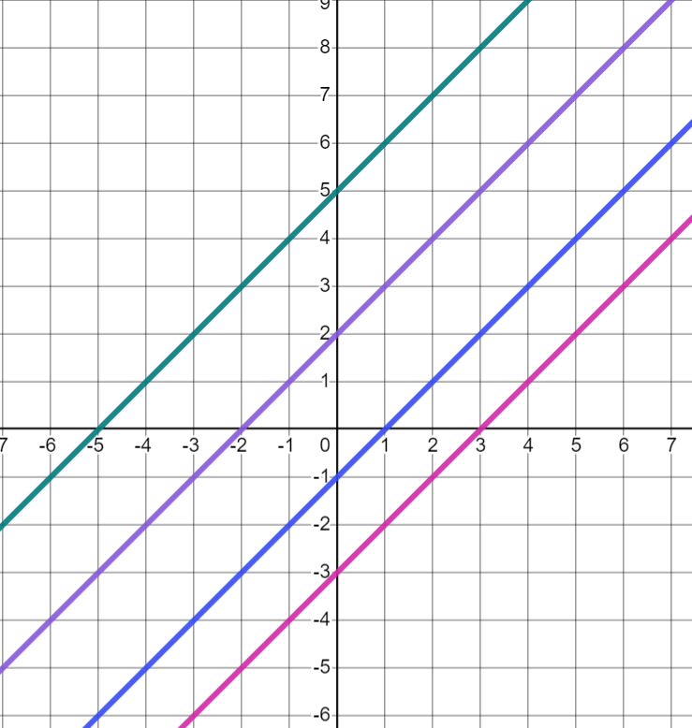
Identifying the y-intercept
What is the same and what is different in the graphs below?
Similarities
All the graphs are straight lines.
They all have the same positive gradient.
They are all parallel.
Differences
They have different ‘heights’ on the graph.
They are translations of one another.
They cross the axes at different points.

Slide 7
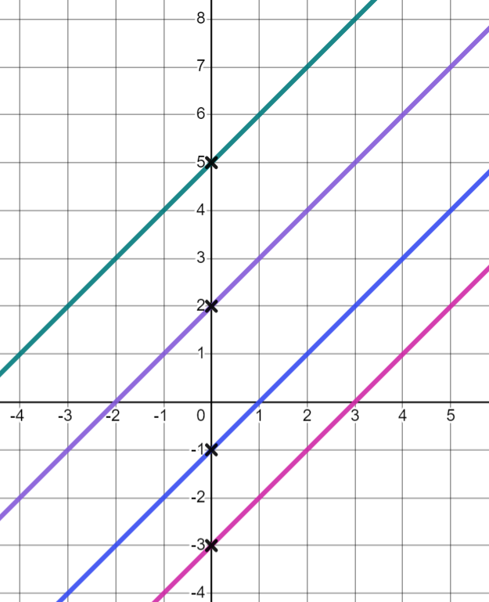
Identifying the y-intercept
We call the coordinate where a graph crosses the y-axis, the y-intercept.
When any linear relationship is plotted, it forms a straight line.
(0,5)
Almost all straight lines will have a coordinate where they cross the y-axis.
(0,2)
Vertical lines are an exception.
Where are the y-intercepts on these graphs?
(0,−1)
What are their coordinates?
(0,−3)

Slide 8
Identifying the y-intercept
What do you notice about these coordinates?
x = 0 (y axis)
The x-coordinate is zero.
Will this be the case for all y-intercepts?
(0,5)
Yes, because the x-coordinate of any point on the y axis is 0
(0,2)
(0,−1)
Another name for the y-axis is x = 0 because all coordinates on that line follow the rule ‘The x-coordinate is 0’
(0,−3)

Slide 9

Identifying the y-intercept
Which of these could represent the y-intercept?
(5,0)
(0,0)
(2,−2)
(0,5)

Slide 10
Identifying the y-intercept
Because we know the y-intercept has an x-coordinate of 0. We can find the y-intercept from a linear relationship.
Where would the y-intercept be if we plotted the relationship y = x + 4?
We can substitute zero (0) for the x-value in the equation y = x + 4?
y = (0) + 4
y = 4
The coordinate of the y-intercept would be (0,4)

Slide 11
Identifying the y-intercept
Where would the y-intercept be if we plotted the relationship x + y = 10?
Again, we can substitute (0) for the x-value in the equation x + y = 10
(0) + y = 10
y has to be equal to 10 to make this true.
Therefore the y-intercept is (0,10)

Slide 12
Identifying the y-intercept
As almost all linear relationships will cross the y axis when plotted, this method will work for graphs of most linear equations.
Some can require more steps to find the y intercept.
Where would the y-intercept be for the relationship 2x − y = −3 ?
2(0) − y = −3
0 − y = −3
y has to be equal to 3 to make this true.
Therefore the y-intercept is (0,3)

Slide 13
Identifying the y-intercept
What value of y will make each equation true?
y + 0 = 4
y = 4
y = 0 − 4
y = −4
0 + y − 2 = 4
y = 6
2y + 0 = 0
y = 0

Slide 14
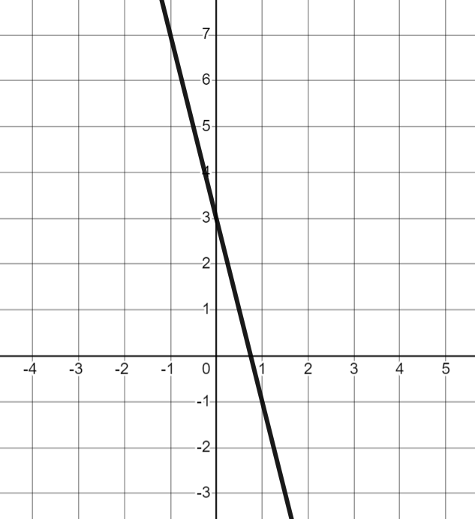
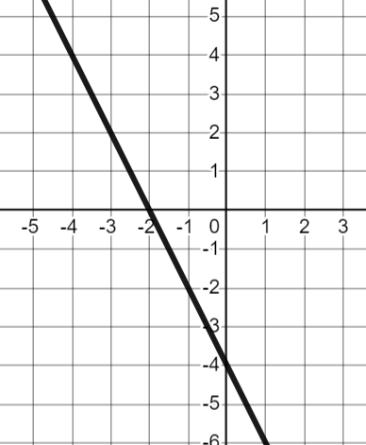
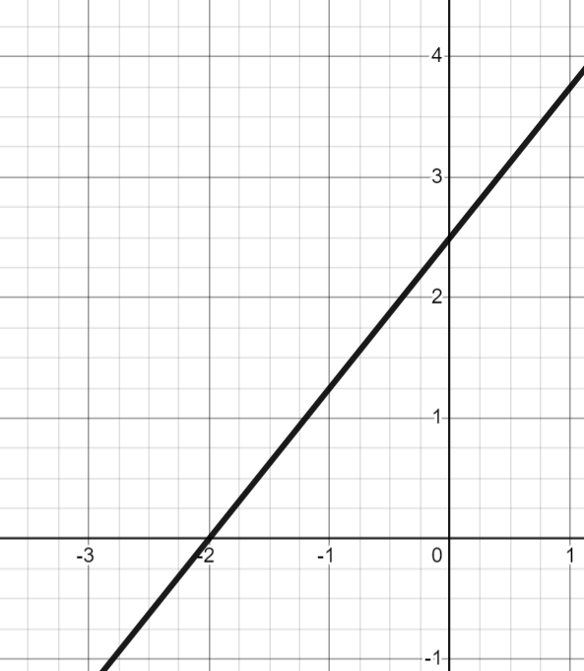
Identifying the y-intercept
For each question, circle the y-intercept on the graph and in the table.
a) | b) | c)
x | 0 | 1 | 2 | 3
y | 3 | −1 | −5 | −9
x | −2 | −1 | 0 | 1
y | 0 | −2 | −4 | −6
x | −2 | 0 | 2 | 4
y | 0 | 2.5 | 5 | 7.5
2) Write the y-intercept for each as a coordinate.

Slide 15
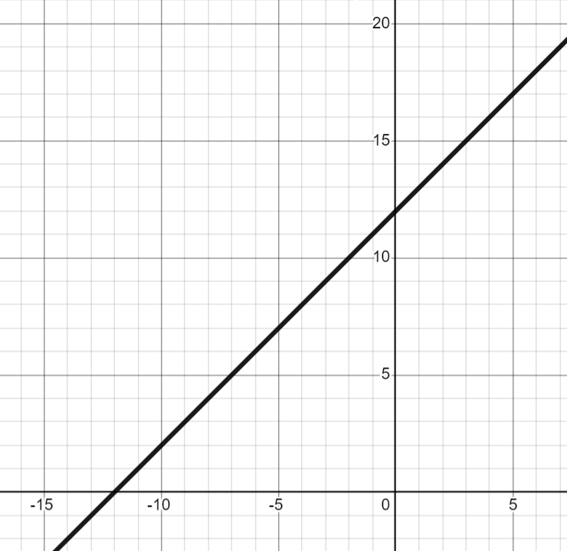
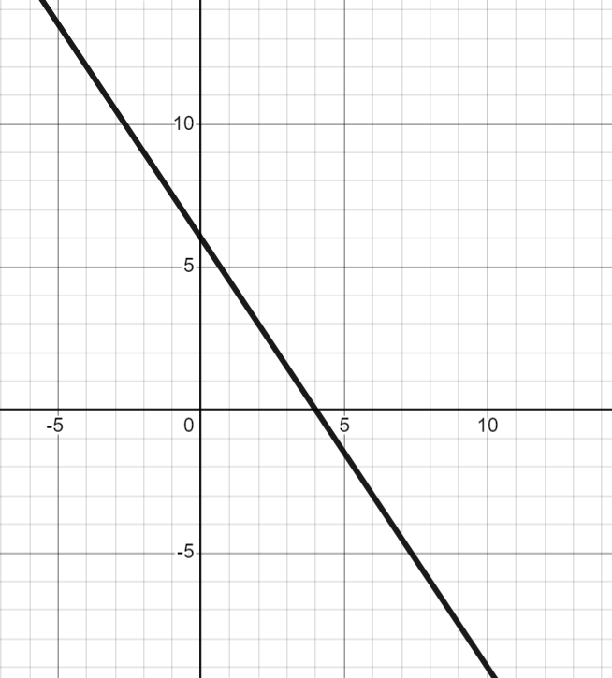
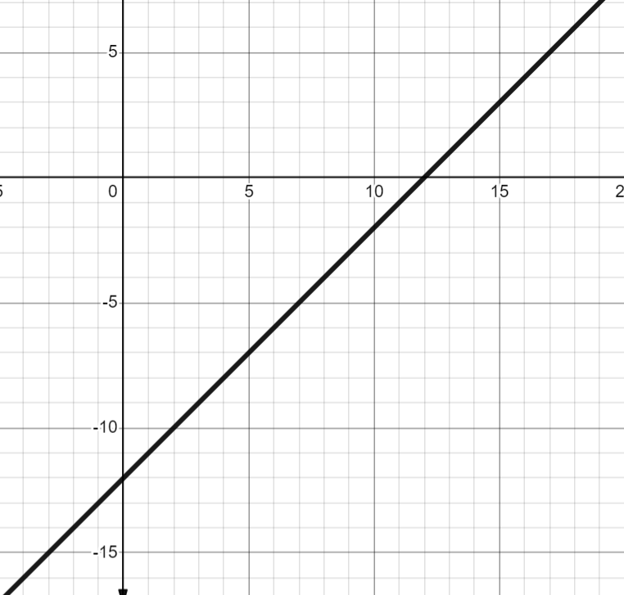
Identifying the y-intercept
3) Match each y-intercept to a graph, a table and an equation.
A (0,6)
B (0,12)
C (0,−12)
D
E
F
G
x | 0 | 2 | 4
y | 6 | 3 | 0
x | −10 | −5 | 0
y | 2 | 7 | 12
x | −1 | 0 | 1
y | −13 | −12 | −11
H
I
J
y = x + 12
K
y + 12 = x
L
2y + 3x − 12 = 0

Slide 16
Identifying the y-intercept
For each question, circle the y-intercept on the graph and in the table.
a) | b) | c)
x | 0 | 1 | 2 | 3
y | 3 | −1 | −5 | −9
x | −2 | −1 | 0 | 1
y | 0 | −2 | −4 | −6
x | −2 | 0 | 2 | 4
y | 0 | 2.5 | 5 | 7.5
(0,3)
(0,−4)
(0,2.5)
2) Write the y-intercept for each as a coordinate.

Slide 17
Identifying the y-intercept
3) Match each y-intercept to a graph, a table and an equation.
A (0,6)
B (0,12)
C (0,−12)
E
D
F
G
x | 0 | 2 | 4
y | 6 | 3 | 0
x | −10 | −5 | 0
y | 2 | 7 | 12
x | −1 | 0 | 1
y | −13 | −12 | −11
H
I
L
2y + 3x − 12 = 0
J
y = x + 12
K
y + 12 = x

Slide 18
The intercept point
Identifying the y-intercept
Calculating the y-intercept from tables of values
Calculating the y-intercept from two coordinates

Slide 19
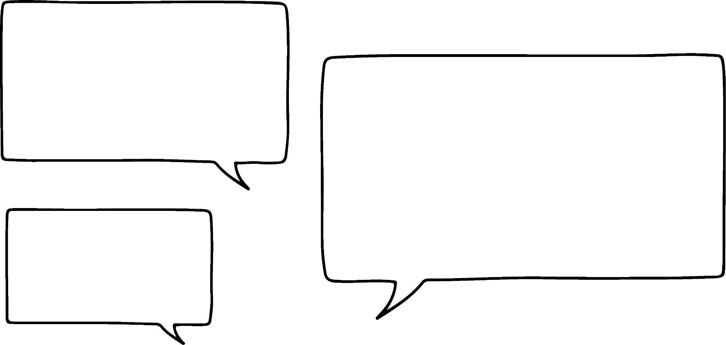


Calculating the y-intercept from tables of values
We can work out the y-intercept if we know any two consecutive coordinates by counting back to an x value of 0
Counting back from 10 will take a while. Is there a quicker way?
x | 10 | 11 | 12
y | 8 | 11 | 14
Sam
+1
+1
+1
+1
+1
+1
+1
+1
+1
+1
x | 0 |  |  |  |  |  |  |  |  |  | 10
y |  |  |  |  |  |  |  |  |  |  | 8
How many steps of 1 are there between 0 and 10?
10

Slide 20
Calculating the y-intercept from tables of values
+1
So there are 10 additions of 3 between the y-intercept and 8
x | 10 | 11 | 12
y | 8 | 11 | 14
3 × 10 = 30
+3
So we need to subtract 30 from 8
+1
+1
+1
+1
+1
+1
+1
+1
+1
+1
x | 0 |  |  |  |  |  |  |  |  |  | 10
y |  |  |  |  |  |  |  |  |  |  | 8
−22
+3
+30
−30
The y-intercept is (0,−22)

Slide 21
Calculating the y-intercept from tables of values
What is the y-intercept for this table of values?
x | −10 | −9 | −8
y | −17 | −12 | −7
When x increases by 1, y increases by 5. The gradient of the line is 5
+5
+40
To get up to an x-coordinate of 0 we need to add 5 eight times.
5 × 8 = 40
−7 + 40 = 33
The y-intercept is (0,33)

Slide 22
Calculating the y-intercept from tables of values
What is the y-intercept for this table of values?
What is the y-intercept for this table of values?
x | 8 | 9 | 10
y | 5 | 3 | 1
x | 12 | 13 | 14
y | 2 | −2 | −6
+16
−2
+ 48
−4
When x-increases by 1, y-decreases by 2. The gradient of the line is −2
When x-increases by 1, y-decreases by 4. The gradient of the line is −4
2 × 8 = 16
4 × 12 = 48
5 + 16 = 21
2 + 48 = 50
The y-intercept is (0,21)
The y-intercept is (0,50)

Slide 23
Calculating the y-intercept from tables of values
For each table of values, work out the y-intercept.
a)
b)
c)
d)
e)
f)
x | 0 | ….. | 2 | 3 | 4
y |  | ….. | 13 | 16 | 19
x | 0 | ….. | 10 | 11 | 12
y |  | ….. | −3 | −8 | −13
x | 0 | ….. | 6 | 7 | 8
y |  | ….. | 19 | 21 | 23
x | −5 | −4 | −3 | ….. | 0
y | 15 | 12 | 9 | …..
x | 0 | ….. | 25 | 26 | 27
y |  | ….. | 17 | 21 | 25
x | −12 | −11 | −10
y | −21 | −15 | −9

Slide 24
Calculating the y-intercept from tables of values
For each table of values, work out the y-intercept.
a)
b)
c)
d)
e)
f)
x | 0 | ….. | 2 | 3 | 4
y | 7 | ….. | 13 | 16 | 19
x | 0 | ….. | 10 | 11 | 12
y | 47 | ….. | −3 | −8 | −13
−6
+3
(0,7)
+50
−5
(0,47)
x | 0 | ….. | 6 | 7 | 8
y | 7 | ….. | 19 | 21 | 23
x | −5 | −4 | −3 | ….. | 0
y | 15 | 12 | 9 | ….. | 0
−12
+2
(0,7)
−3
−9
(0,0)
x | 0 | ….. | 25 | 26 | 27
y | −83 | ….. | 17 | 21 | 25
x | −12 | −11 | −10
y | −21 | −15 | −9
(0,51)
(0,−83)
−100
+4
+6
+60

Slide 25
The intercept point
Identifying the y-intercept
Calculating the y-intercept from tables of values
Calculating the y-intercept from two coordinates

Slide 26
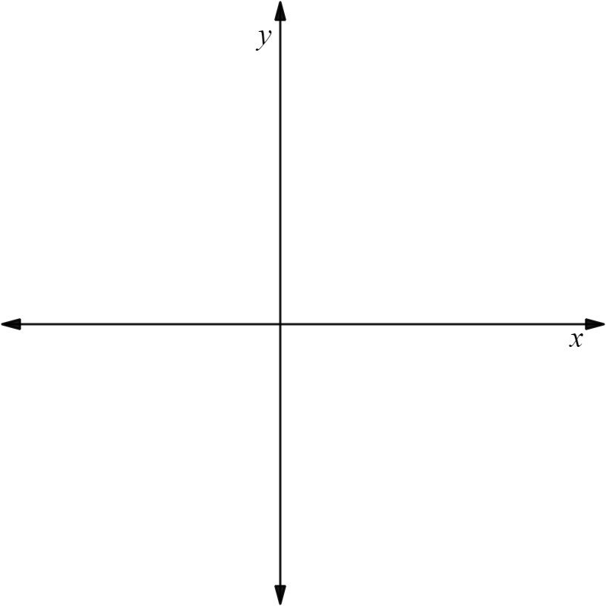
Calculating the y-intercept from two coordinates
We can work out the y-intercept if we know 2 coordinates on the line.
What would the y-intercept be for the line that goes through (4,10) and (7, 16)?
(7,16)
×
It is useful to sketch the points roughly first.
(4,10)
×
However we do not know if the y-intercept is positive or negative, so this is just a guide.

Slide 27
Calculating the y-intercept from two coordinates
Once you have sketched your points, calculate the gradient.
We are expecting it to be positive.
Change in x | Change in y
(7,16)
×
gradient = 2
3
6
+6
(4,10)
×
1
2
+3
We can put the coordinates into a table of values to help us count back to the y-intercept.
2 × 4 = 8
x | 0 | ….. | 4 | ….. | 7
y |  | ….. | 10 | ….. | 16
10 − 8 = 2
2
The y-intercept is (0,2)
−8
+2

Slide 28


Calculating the y-intercept from two coordinates
We can check that our y-intercept is correct by seeing if it works for the second coordinate too.
What is the y-intercept for the line which passes through the coordinates (8,1) and (12,3)
Change in x | Change in y
+4
+2
4
2
1
(8,1)
(12,3)
gradient =
x | 0 | ….. | 8 | ….. | 12
y |  | ….. | 1 | ….. | 3
The y-intercept is (0,−3)
× 8 = 4
−3
1 − 4 = −3
−4

Slide 29
Calculating the y-intercept from two coordinates
Now we can check with the coordinate (12,3)
Change in x | Change in y
4 | 2
1
gradient =
× 12 = 6
3 − 6 = −3
x | 0 | ….. | 8 | ….. | 12
y |  | ….. | 1 | ….. | 3
The y-intercept is (0,−3)
−3
−6
It looks like the y-intercept is (0, −3) as it works for a gradient of with both coordinates.

Slide 30
Calculating the y-intercept from two coordinates
This is a really useful way of checking some of your working.
However it is possible to get the same incorrect coordinate for the y-intercept if you have made multiple mistakes.
Make sure you check your working for the gradient before using your second coordinate to check your y-intercept.

Slide 31

Calculating the y-intercept from two coordinates
Laura has tried to work out the y-intercept for the line passing through (7,15) and (10,21). Identify any mistakes.
+2
+6
x | 0 | ... | 7 | ... | 10
y |  | … | 15 | … | 21
x | 0 | ... | 7 | ... | 10
y |  | … | 15 | … | 21
(7,15)
(10,21)
3 × 7 = 24
3 × 10 = 30
Change in x | Change in y
2 | 6
1 | 3
15 − 24 = −9
21 − 30 = −9
The y-intercept is (0,−9)
I have checked the y-intercept is (0,−9)
gradient = 3

Slide 32
Calculating the y-intercept from two coordinates
Laura has tried to work out the y-intercept for the line passing through (7,15) and (10,21). Spot where she has gone wrong.
+2
+6
x | 0 | ... | 7 | ... | 10
y |  | … | 15 | … | 21
x | 0 | ... | 7 | ... | 10
y |  | … | 15 | … | 21
(7,15)
(10,21)
3 × 7 = 24
3 × 10 = 30
Change in x | Change in y
2 | 6
1 | 3
15 − 24 = −9
21 − 30 = −9
3
2
I have checked the y-intercept is (0,−9)
The y-intercept is (0,−9)
gradient = 3
The +2 should be a +3. The gradient should be 2
3 × 7 = 21 not 24. It should be 2 × 7 = 14
Answer should be (0,1)

Slide 33
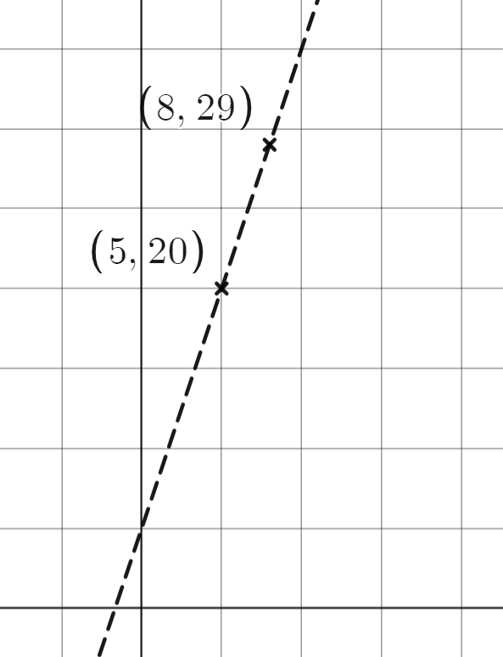
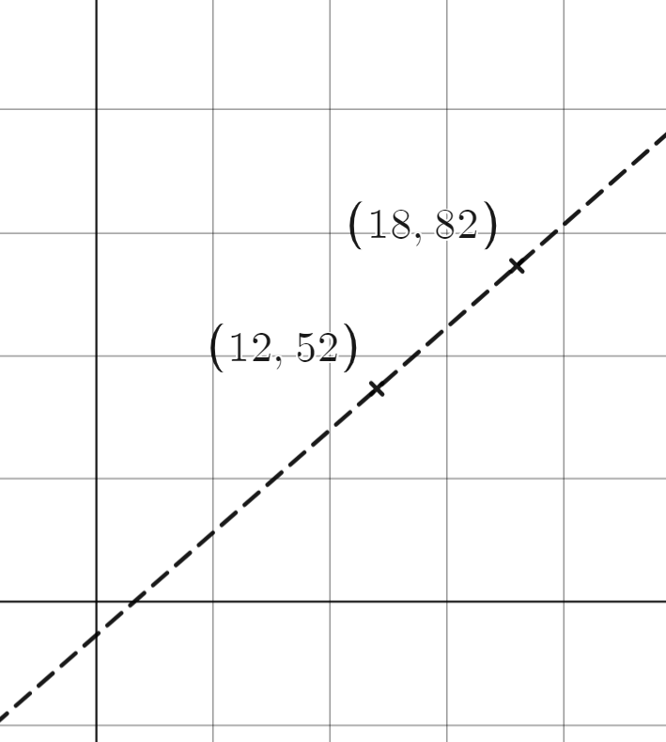
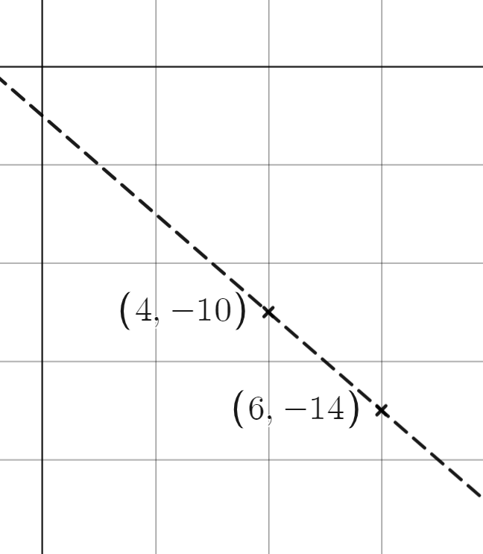
Calculating the y-intercept from two coordinates
For each pair of coordinates, work out the y-intercept for the line which passes through them.
a) (5, 20) and (8,29) | b) (12,52) and (18,82) | c) (4,−10) and (6,−14)
3 | 9
1
6
1
2 | −4
gradient =
gradient =
x | 0 | ….. | 5 | ….. | 8
y |  | ….. | 20 | ….. | 29
x | 0 | ….. | 12 | ….. | 18
y |  | ….. | 52 | ….. | 82
x | 0 | ….. | 4 | ….. | 6
y |  | ….. | −10 | ….. | −14
y-intercept = ( , )
y-intercept = ( , )
y-intercept = ( , )

Slide 34
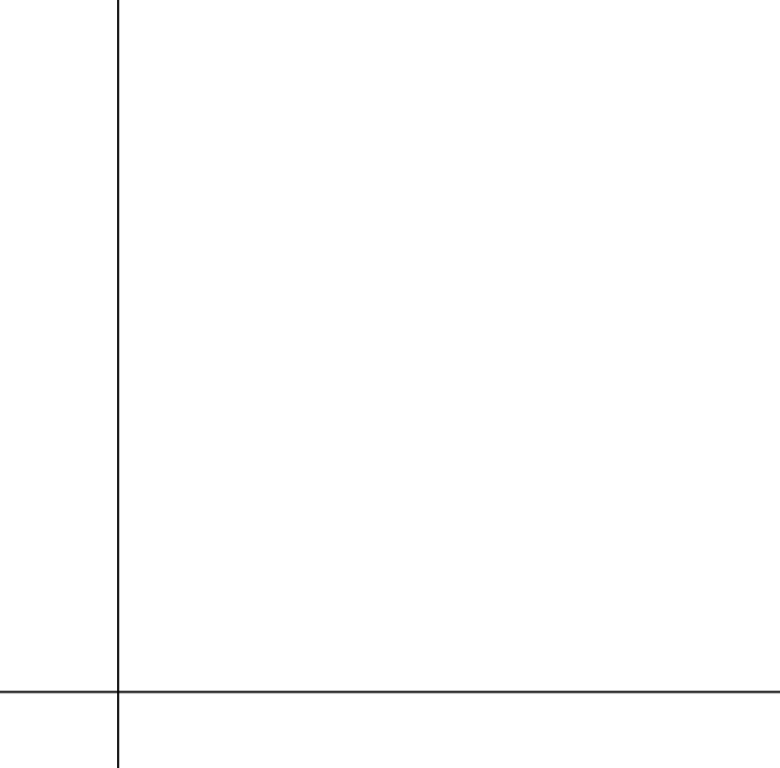
Calculating the y-intercept from two coordinates
For each pair of coordinates, work out the y-intercept for the line which passes through them.
d) (10,8) and (18,0) | e) (7,33) and (10,75) | f) (6,13) and (9,22)
gradient =
x |  |  | 10 | ….. | 18
y |  |  |  | …..
x |  |  | 7 | ….. | 10
y |  |  |  | …..
y-intercept = ( , )
y-intercept = ( , )
y-intercept = ( , )

Slide 35
Calculating the y-intercept from two coordinates
For each pair of coordinates, work out the y-intercept for the line which passes through them.
a) (5, 20) and (8,29) | b) (12,52) and (18,82) | c) (4,−10) and (6,−14)
3 | 9
1 | 3
6 | 30
1 | 5
2 | −4
1 | −2
gradient = 3
gradient = 5
x | 0 | ….. | 5 | ….. | 8
y | 5 | ….. | 20 | ….. | 29
x | 0 | ….. | 12 | ….. | 18
y | −8 | ….. | 52 | ….. | 82
x | 0 | ….. | 4 | ….. | 6
y | −2 | ….. | −10 | ….. | −14
y-intercept = (0,5)
y-intercept = (0,−8)
y-intercept = (0,−2)

Slide 36
Calculating the y-intercept from two coordinates
For each pair of coordinates, work out the y-intercept for the line which passes through them.
d) (10,8) and (18,0) | e) (7,54) and (10,75) | f) (6,13) and (9,22)
8 | −8
1 | −1
3 | 21
1 | 7
3 | 9
1 | 3
gradient = 7
gradient = 3
x | 0 |  | 6 | ….. | 9
y | −5 |  | 13 | ….. | 22
x | 0 |  | 10 | ….. | 18
y | 18 |  | 8 | ….. | 0
x | 0 |  | 7 | ….. | 10
y | 5 |  | 54 | ….. | 75
y-intercept = (0,−5)
y-intercept = (0,18)
y-intercept = (0,5)

Slide 37
The intercept point
The y-intercept is the coordinate where a graph crosses the y axis.
The y-intercept can be found from a graph, table or relationship.
The y-intercept can be found from two coordinates by finding the gradient between them.

Slide 38

© Oak National Academy 2023.
Produced in partnership with Mathematics in Education and Industry.
Licensed on the Open Government Licence v3.0, except where otherwise stated. See Oak terms and conditions.

